Slide 1
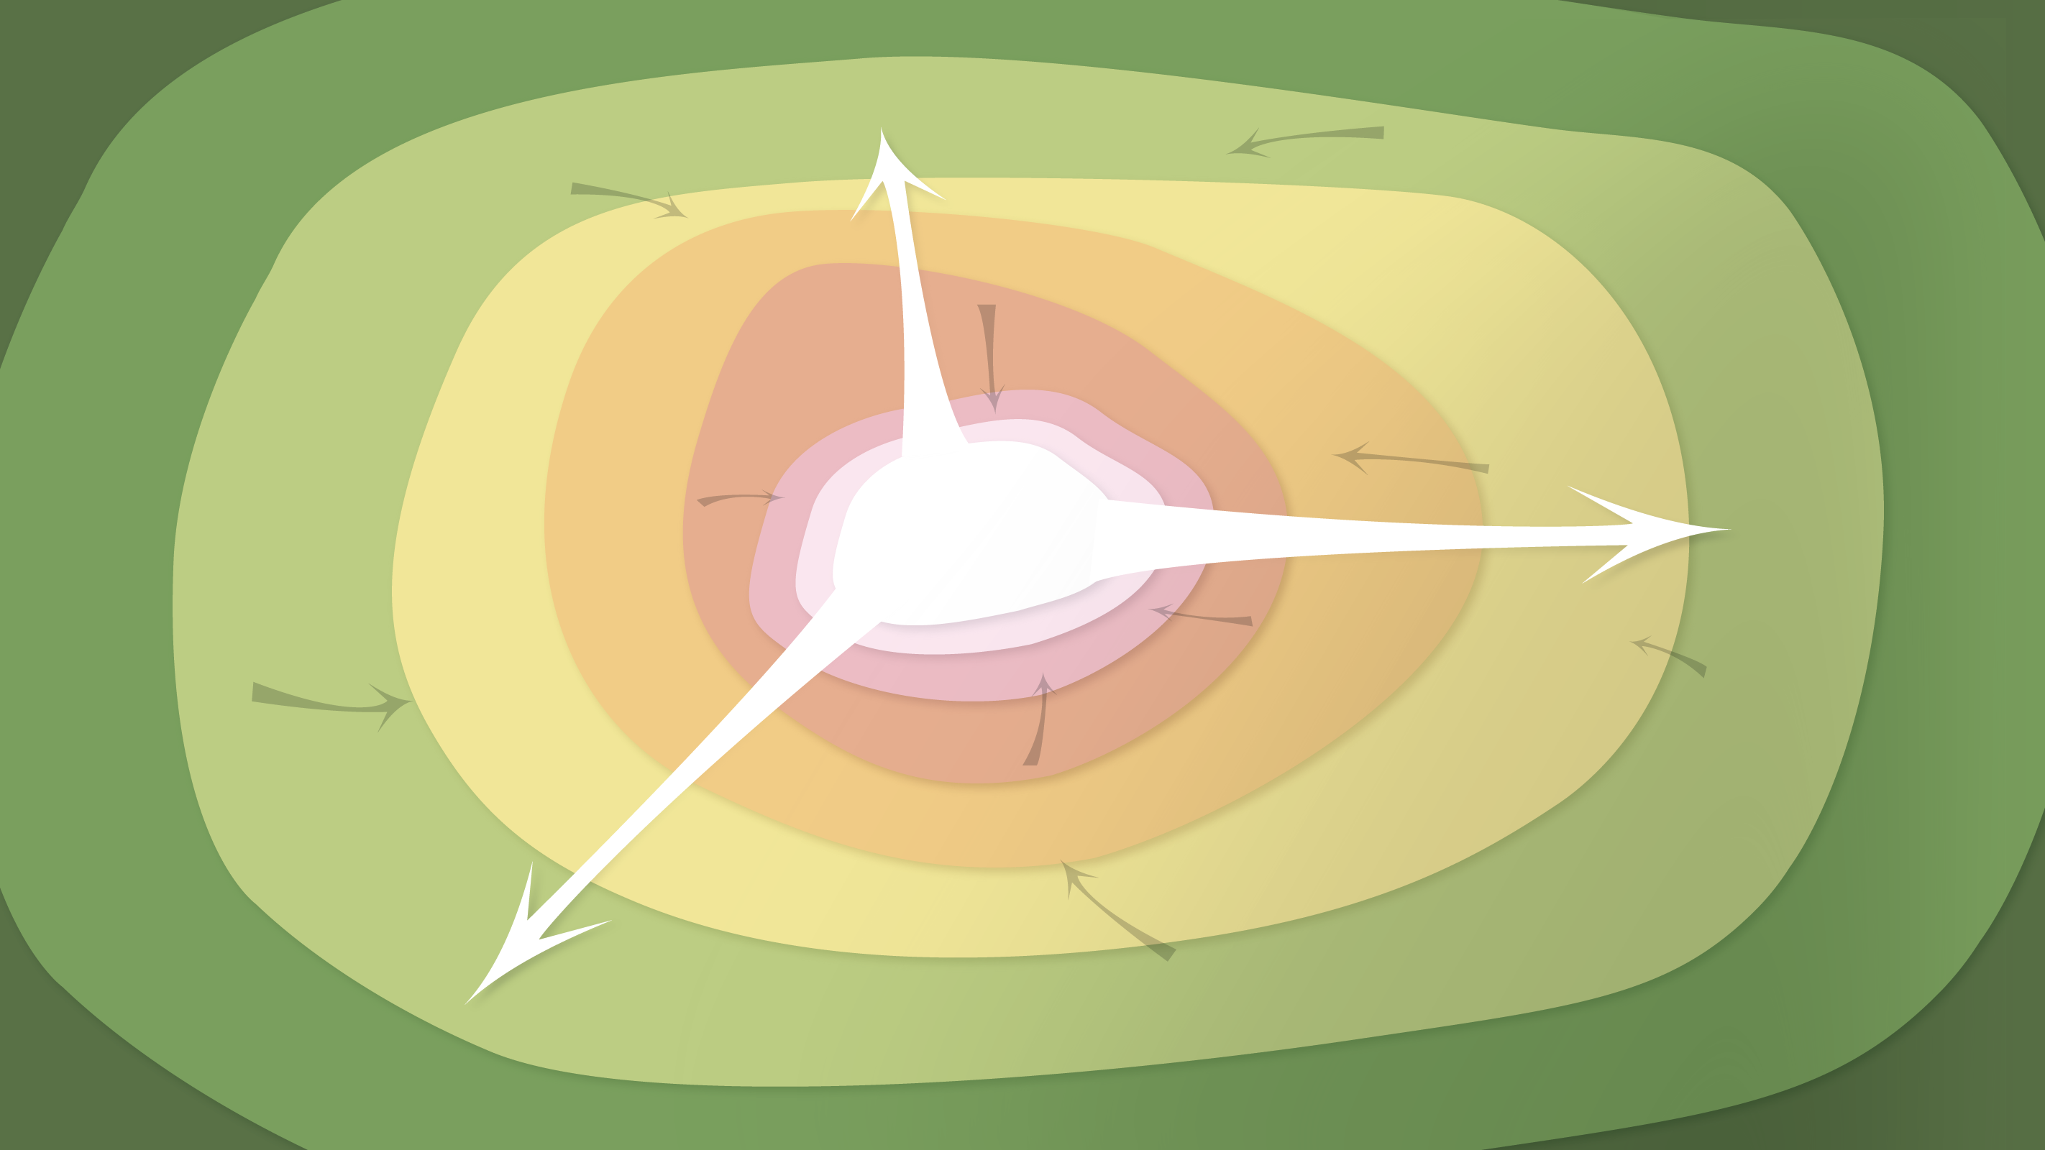
Data Curation
for liaison librarians
Timothy Norris – tnorris@miami.edu
Fall 2016 – Library Seminar

Slide 2
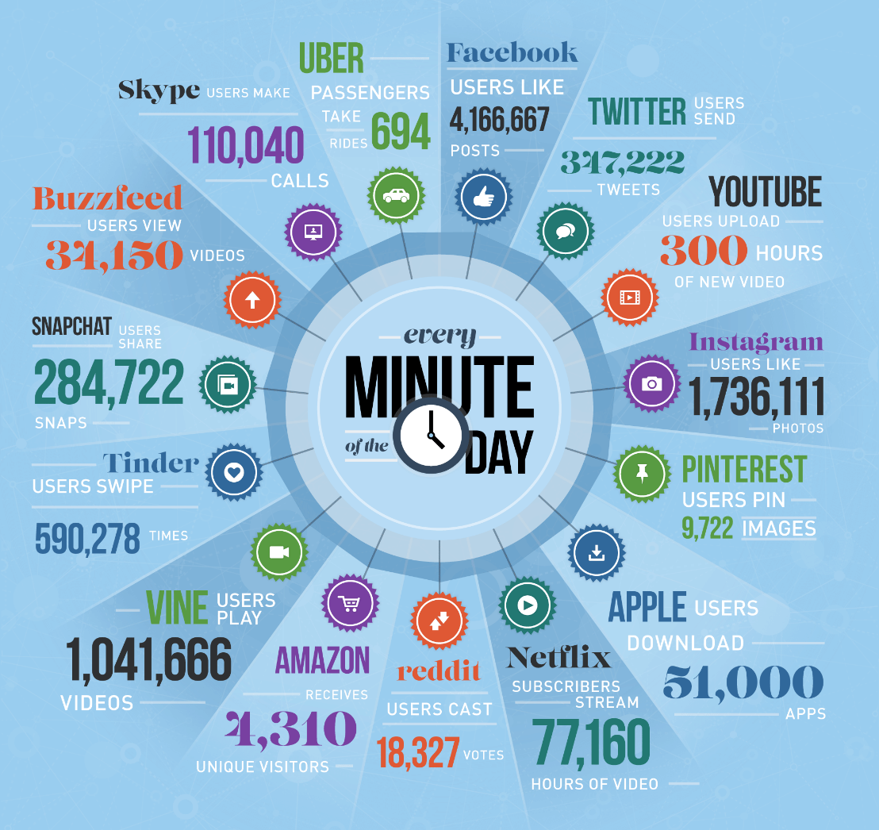
Big Data
https://www.domo.com/blog/2015/08/data-never-sleeps-3-0/

Slide 3
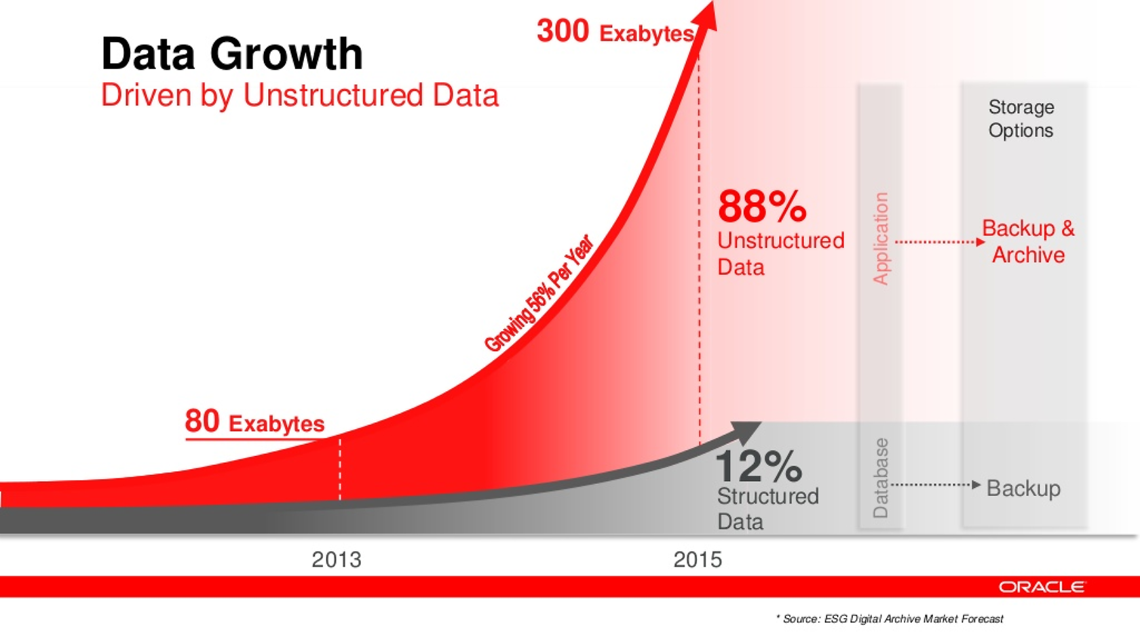
Navarro, Fran (2014). Foco en Almacenamiento. Accessed from http://www.slideshare.net/franmod/tendencias-storage. Slide 42.

Slide 4
Useful generalizations
WISDOM
applied knowledge
“Information is not knowledge.
Knowledge is not wisdom.
Wisdom is not truth.
Truth is not beauty.
Beauty is not love.
Love is not music.
Music is THE BEST.”
― Frank Zappa
KNOWLEDGE
organized information
INFORMATION
linked elements
DATA
abstracted elements
WORLD

Slide 5
Sensors and Data Levels
Active vs. Static: | Data Stage: | Example or Focus: | Typical File Formats:
ACTIVE | Raw Data: | Temperature readings over time | Paper? Device-specific? .xlsx, …
 | Processed Data: | “Cleaned,” normalized temperature data compiled in spreadsheet | .xlsx, .sas, …
 | Analyzed Data: | Temperature data with averages computed, graphs charted | .xlsx, .sas, …
STATIC | Finalized, Published Data: | Do the data support hypothesis? | .csv
http://classguides.lib.uconn.edu/content.php?pid=355458&sid=3391384

Slide 6

The Data Deluge
Data Sharing Requirements
NIH: October 2003
Data Management Requirements
NSF: Jan 2011
NEH: June 2011
The 2013 OSTP Memo: Open Data
Federally funded research results should be made accessible to the public
Both peer-reviewed publications and data
Notes:
The Matrix - 1999
Big Data . . .
Talk to the data deluge, what are the responses in academia? In the public sector? Perhaps this is why we are here today?
NIH early data sharing requirements from grants over $500,000 – stringent controls for privacy and proprietary data
The 2011 NSF requirement to have data management plans in the grant proposals – there are program specific requirements
Most are simply two page documents with requirements to outline:
Data types to be collected
Standards to be used for metadata and data
Sharing policies (access, privacy, IP, etc.)
Re-use policies (distribution, derivatives
Plans for archival
Note that these requirements caused quite the scramble. No grant money if you could not include a plan.
Note that many foundations now also have data management requirements
Even private sector contracts require data management planning

Slide 7
What is DATA Management?
¿Data?
“Examples of Research Data and Materials include laboratory notebooks, notes of any type, photographs, films, digital images, original biological and environmental samples, protocols, numbers, graphs, charts, numerical raw experimental results, instrumental outputs from which Research Data can be derived and other deliverables under sponsored agreements.”
Johns Hopkins University (2008)
http://jhuresearch.jhu.edu/Data_Management_Policy.pdf
Numbers
Words
Citations / references
Notebooks / marginalia
Specimens
Field Samples
Images
Videos / sound recording
Relationships
Models
Code
Notes:
The Matrix - 1999
Big Data . . .
Talk to the data deluge, what are the responses in academia? In the public sector? Perhaps this is why we are here today?
NIH early data sharing requirements from grants over $500,000 – stringent controls for privacy and proprietary data
The 2011 NSF requirement to have data management plans in the grant proposals – there are program specific requirements
Most are simply two page documents with requirements to outline:
Data types to be collected
Standards to be used for metadata and data
Sharing policies (access, privacy, IP, etc.)
Re-use policies (distribution, derivatives
Plans for archival
Note that these requirements caused quite the scramble. No grant money if you could not include a plan.
Note that many foundations now also have data management requirements
Even private sector contracts require data management planning

Slide 8
What is DATA Management?
¿Data?
Definitions: The term “Research Data” in this document refers to information recorded and/or collected for research performed at or under the auspices of the University regardless of the form or the media upon which it is recorded. This term includes, but is not limited to, computer programs (code and documentation), computer databases, instrumental outputs, raw numerical results, original biological or environmental samples, photographs, digital images, films, protocols, graphs, and other deliverables produced under sponsored agreements. Research Data also includes any records related to the design, conduct or reporting of the research that would be necessary to reconstruct the reported research results. Research data can be intangible (statistics, findings, conclusions, etc.) and tangible (notebooks, printouts, etc.).
Notes:
The Matrix - 1999
Big Data . . .
Talk to the data deluge, what are the responses in academia? In the public sector? Perhaps this is why we are here today?
NIH early data sharing requirements from grants over $500,000 – stringent controls for privacy and proprietary data
The 2011 NSF requirement to have data management plans in the grant proposals – there are program specific requirements
Most are simply two page documents with requirements to outline:
Data types to be collected
Standards to be used for metadata and data
Sharing policies (access, privacy, IP, etc.)
Re-use policies (distribution, derivatives
Plans for archival
Note that these requirements caused quite the scramble. No grant money if you could not include a plan.
Note that many foundations now also have data management requirements
Even private sector contracts require data management planning

Slide 9
What is DATA Management?
¿Data is included as an innovation!?
Innovations: patentable or un-patentable inventions, discoveries, processes, compositions, research tools, data, ideas, databases, know-how, copyrightable works that are not scholarly or artistic Creations and tangible property, including biological organisms, engineering prototypes, drawings, and software created, conceived or made by Applicable Personnel within their normal duties (including clinical duties), course of studies, field of research or scholarly expertise or making more than Incidental Use of University’s resources. (2016-17 Faculty Manual, p. 136)
Notes:
The Matrix - 1999
Big Data . . .
Talk to the data deluge, what are the responses in academia? In the public sector? Perhaps this is why we are here today?
NIH early data sharing requirements from grants over $500,000 – stringent controls for privacy and proprietary data
The 2011 NSF requirement to have data management plans in the grant proposals – there are program specific requirements
Most are simply two page documents with requirements to outline:
Data types to be collected
Standards to be used for metadata and data
Sharing policies (access, privacy, IP, etc.)
Re-use policies (distribution, derivatives
Plans for archival
Note that these requirements caused quite the scramble. No grant money if you could not include a plan.
Note that many foundations now also have data management requirements
Even private sector contracts require data management planning

Slide 10


Why Manage Data
Productivity
Publishing
Knowledge creation
Career advancement
¿ SOMETHING ELSE?
+
Compliance
Grant writing
University policy
Research ethics
http://www.pd4pic.com/images800_/carrot-orange-vegetable.png
http://www.pd4pic.com/images/stick-outline-tree-branch-wood.png

Slide 11
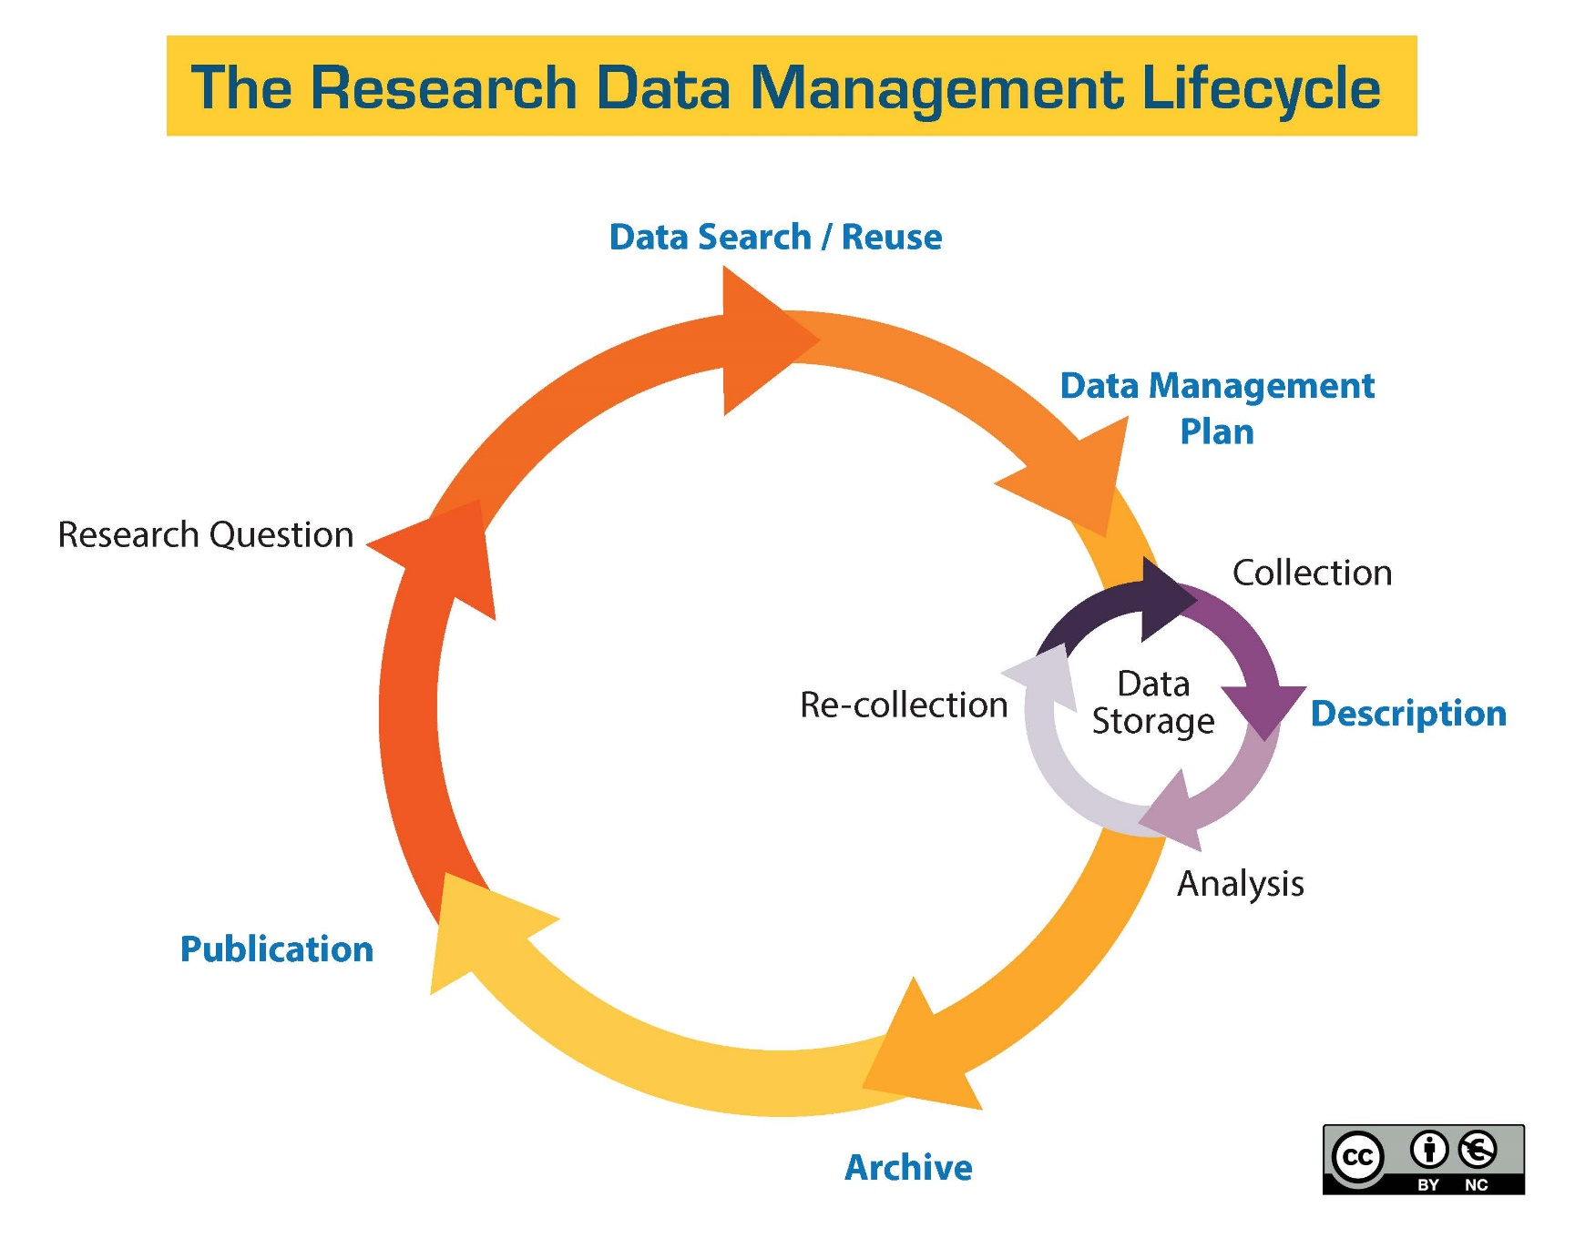
http://guides.library.ucsc.edu/datamanagement/

Slide 12
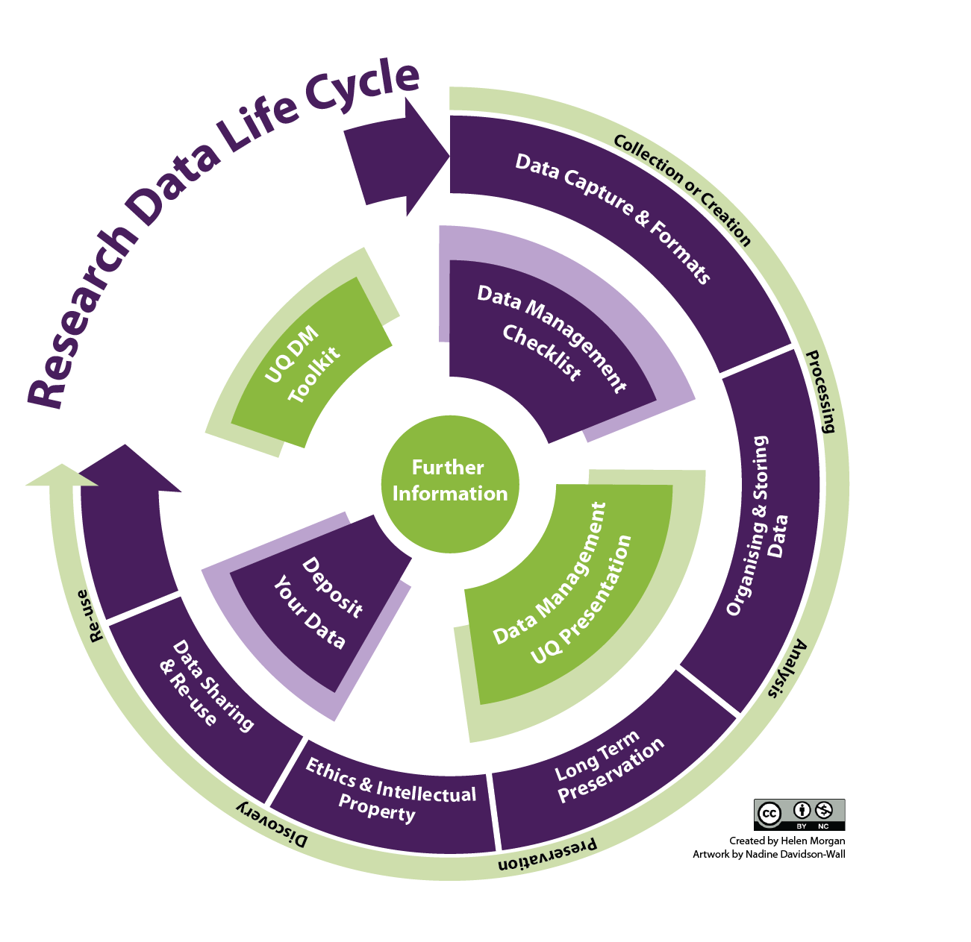
http://libguides.ucd.ie/data

Slide 13
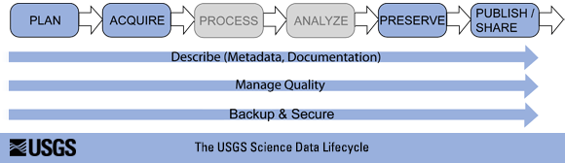
Research Data Lifecycle
http://www.usgs.gov/datamanagement/images/figures/USGS-data-lifecycle-model.png

Slide 14
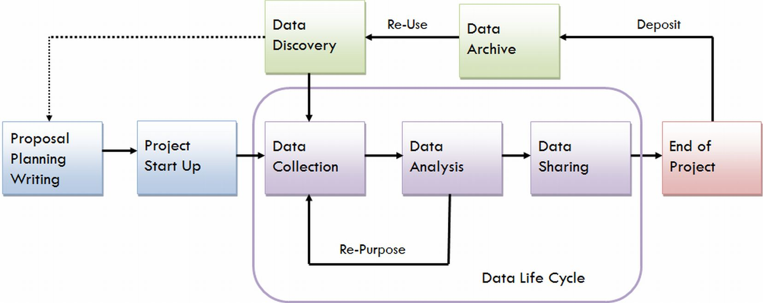
Research Data Lifecycle
https://data.library.virginia.edu/files/Research-Life-Cycle-LG.png

Slide 15
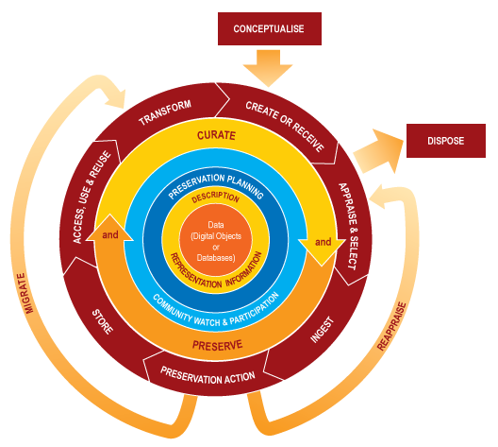
Data Curation Lifecycle
http://www.dcc.ac.uk/resources/curation-lifecycle-model

Slide 16

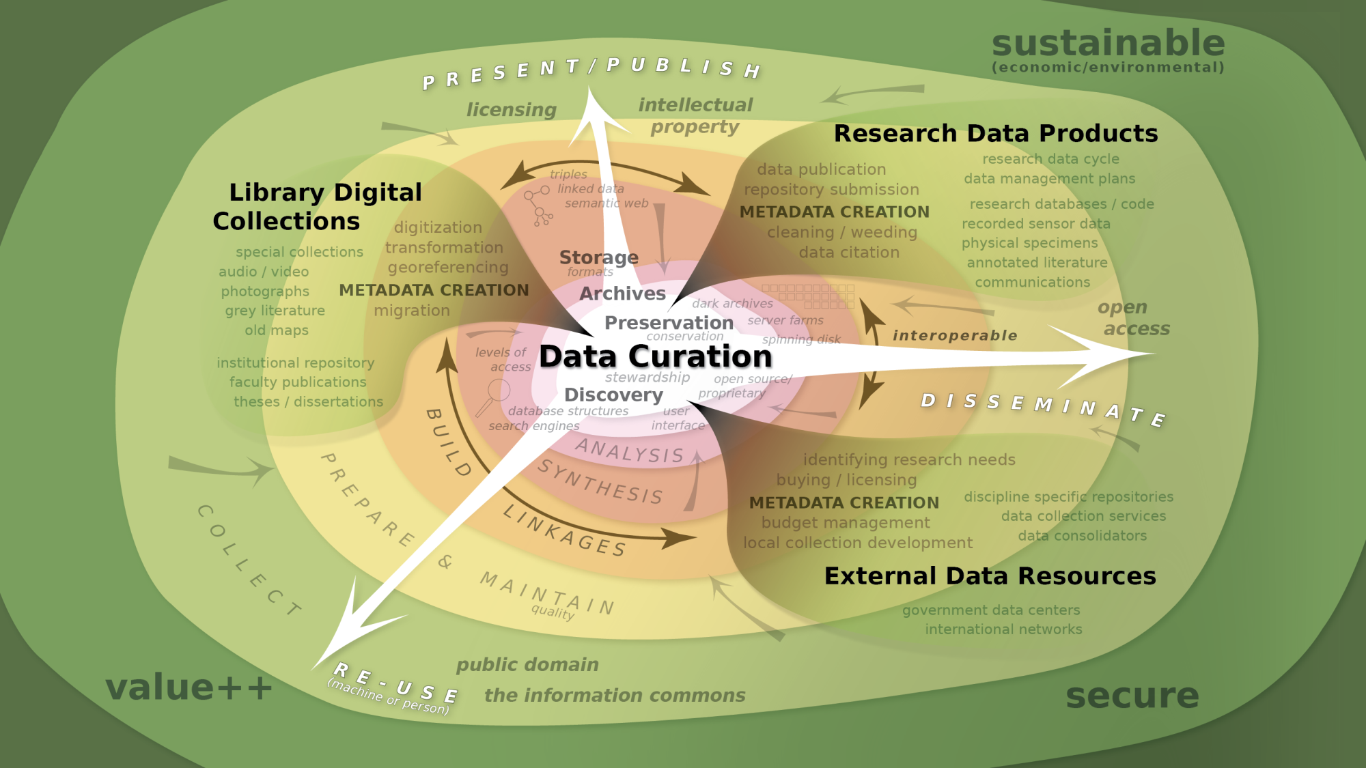
Notes:
So we are left with this complex view (strategic pause)
Re-emphasize the role of the curator as a collaborator in the creation of metadata and a builder of relationships.
Copyright and access metadata? Who polices? Is the metadata stable? Are links persistant? GATEKEEPERS
(illustrator 20)

Slide 17
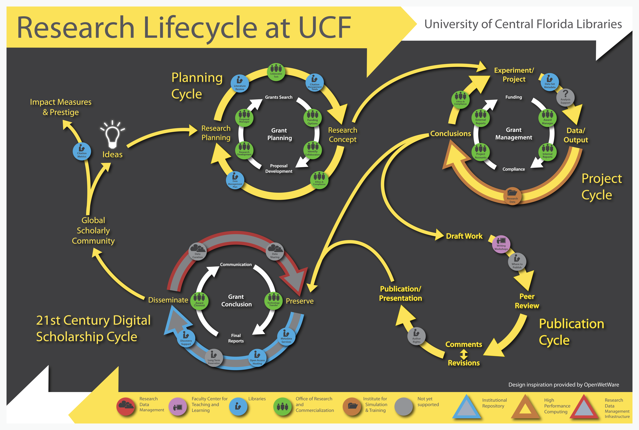
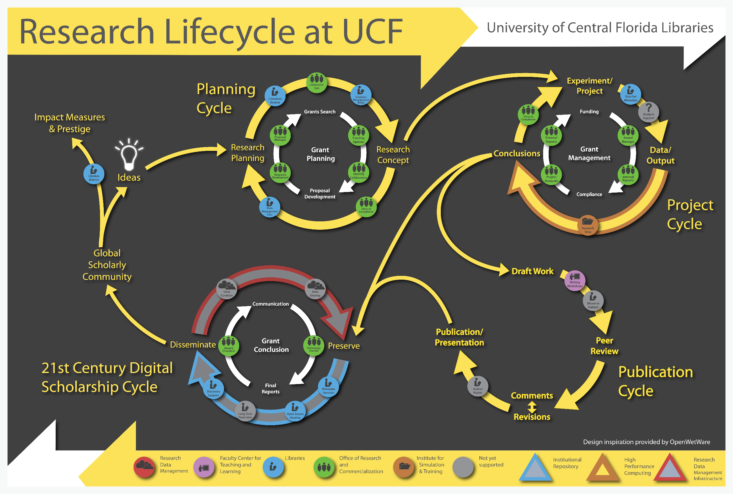
http://library.ucf.edu/about/departments/scholarly-communication/research-lifecycle/

Slide 18
and Research DATA Management?
Before: Data Management Planning / Grant Process
During: Compliance and Productivity
During: Compliance and Productivity
After: Publication and/or Repository Deposit
After: Publication and/or Repository Deposit
Notes:
The Matrix - 1999
Big Data . . .
Talk to the data deluge, what are the responses in academia? In the public sector? Perhaps this is why we are here today?
NIH early data sharing requirements from grants over $500,000 – stringent controls for privacy and proprietary data
The 2011 NSF requirement to have data management plans in the grant proposals – there are program specific requirements
Most are simply two page documents with requirements to outline:
Data types to be collected
Standards to be used for metadata and data
Sharing policies (access, privacy, IP, etc.)
Re-use policies (distribution, derivatives
Plans for archival
Note that these requirements caused quite the scramble. No grant money if you could not include a plan.
Note that many foundations now also have data management requirements
Even private sector contracts require data management planning

Slide 19
and Research DATA Management?
Before: Data Management Planning / Grant Process
Privacy/Security Considerations
Storage and backup strategies
File System Organization
File Naming Conventions
File Format Choice
Documentation and metadata
Roles and responsibilities in research environment
Sharing and collaboration strategies
Ownership of data
Access strategies / Access restrictions
During: Compliance and Productivity
After: Publication and/or Repository Deposit
Notes:
The Matrix - 1999
Big Data . . .
Talk to the data deluge, what are the responses in academia? In the public sector? Perhaps this is why we are here today?
NIH early data sharing requirements from grants over $500,000 – stringent controls for privacy and proprietary data
The 2011 NSF requirement to have data management plans in the grant proposals – there are program specific requirements
Most are simply two page documents with requirements to outline:
Data types to be collected
Standards to be used for metadata and data
Sharing policies (access, privacy, IP, etc.)
Re-use policies (distribution, derivatives
Plans for archival
Note that these requirements caused quite the scramble. No grant money if you could not include a plan.
Note that many foundations now also have data management requirements
Even private sector contracts require data management planning

Slide 20
and Research DATA Management?
Before: Data Management Planning / Grant Process
During: Compliance and Productivity
Follow file naming, organization and format conventions
Documentation and metadata
Acquiring and cleaning data
Regularly backup all data
Be mindful when sharing / version control
Access / privacy policy enforcement
After: Publication and/or Repository Deposit
Notes:
The Matrix - 1999
Big Data . . .
Talk to the data deluge, what are the responses in academia? In the public sector? Perhaps this is why we are here today?
NIH early data sharing requirements from grants over $500,000 – stringent controls for privacy and proprietary data
The 2011 NSF requirement to have data management plans in the grant proposals – there are program specific requirements
Most are simply two page documents with requirements to outline:
Data types to be collected
Standards to be used for metadata and data
Sharing policies (access, privacy, IP, etc.)
Re-use policies (distribution, derivatives
Plans for archival
Note that these requirements caused quite the scramble. No grant money if you could not include a plan.
Note that many foundations now also have data management requirements
Even private sector contracts require data management planning

Slide 21
and Research DATA Management?
Before: Data Management Planning / Grant Process
During: Compliance and Productivity
After: Publication and/or Repository Deposit
Publish
Deposit in a repository
Notes:
The Matrix - 1999
Big Data . . .
Talk to the data deluge, what are the responses in academia? In the public sector? Perhaps this is why we are here today?
NIH early data sharing requirements from grants over $500,000 – stringent controls for privacy and proprietary data
The 2011 NSF requirement to have data management plans in the grant proposals – there are program specific requirements
Most are simply two page documents with requirements to outline:
Data types to be collected
Standards to be used for metadata and data
Sharing policies (access, privacy, IP, etc.)
Re-use policies (distribution, derivatives
Plans for archival
Note that these requirements caused quite the scramble. No grant money if you could not include a plan.
Note that many foundations now also have data management requirements
Even private sector contracts require data management planning

Slide 22
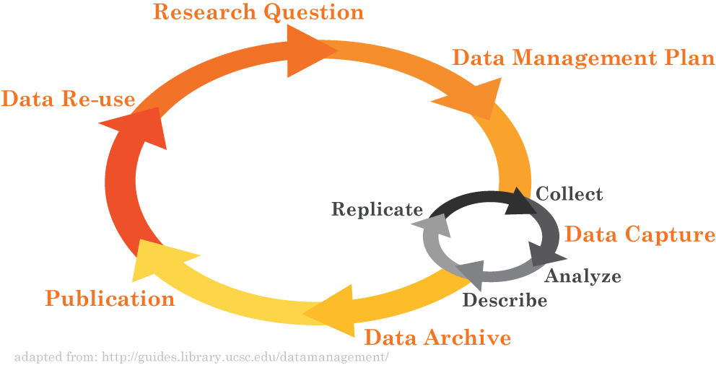
Research Data Lifecycle
http://library.miami.edu/datacuration/

Slide 23




Federal movement toward open data
1985: National Research Council
1999: OMB Circular A-110 revisions
2003: NIH Data Sharing Policy
2008: NIH Public Access Policy
2011: NSF DMP requirement
2012: NEH, Office of Digital Humanities DMP requirement
2013: NSF bio-sketch change
2013: OSTP memo on public access to results of federally funded data
Whitmire, Amanda L. (2014). Research Data Management Curriculum, Lecture 2: Introduction to Research Data Management. Oregon State University Libraries. Retrieved 11/04/2015 from: http://figshare.com/articles/GRAD521_Research_Data_Management_Lectures/1003835
Notes:
The push for improved data management and sharing has really been made by the federal government, including the Executive Office of the President and individual funding agencies. Here’s a brief timeline:
1985: National Research Council releases a book through the National Academies Press titled, “Sharing Research Data.” Makes recommendation that “Sharing research data should be a regular practice.” http://www.nap.edu/openbook.php?record_id=2033
11/19/93, amended 9/30/99: OMB Circular A-110 “Uniform Administrative Requirements for Grants and Agreements With Institutions of Higher Education, Hospitals, and Other Non-Profit Organizations” – all scientific data, including notebooks, must be maintained for three years [after a project concludes] in order to be able to comply with FOIA requests.
October 1, 2003: NIH institutes data sharing policy: “all investigator-initiated applications with direct costs greater than $500,000 in any single year will be expected to address data sharing in their application.” The NIH funds approximately 50,000 research grants per year with a research budget of $16-17B.
2008 NIH public access policy: “The Director of the National Institutes of Health ("NIH") shall require in the current fiscal year and thereafter that all investigators funded by the NIH submit or have submitted for them to the National Library of Medicine's PubMed Central an electronic version of their final, peer-reviewed manuscripts upon acceptance for publication, to be made publicly available no later than 12 months after the official date of publication: Provided, that the NIH shall implement the public access policy in a manner consistent with copyright law.” http://publicaccess.nih.gov/policy.htm
January 18, 2011: NSF starts requiring a 2-page data management plan with ALL proposals. The NSF funds approximately 11,500 grants per year with $7B in grant funding.
2012 NEH Office of Digital Humanities DMP requirement: http://www.neh.gov/files/grants/data_management_plans_2014.pdf
2013 NSF biosketch change, includes datasets as “products of work”. “Instructions for preparation of the Biographical Sketch have been revised to rename the "Publications" section to "Products" and amend terminology and instructions accordingly. This change makes clear that products may include, but are not limited to, publications, data sets, software, patents, and copyrights. “ http://www.nsf.gov/pubs/2013/nsf13004/nsf13004.jsp
Slide adapted from: Heather Coates, Data Management Lab: Session 1 Slides
http://www.slideshare.net/goldenphizzwizards/data-mgmtlab-spr14mod1slides201403245

Slide 24

Next steps
http://opendataenterprise.org/reports/transition-report.pdf

Slide 25
The 2013 OSTP Memo
Transparency and efficiency
Growth, security, value
Commercial re-use and innovation
Data (from OMB Circular 110):
“Data is defined … as the digitally recorded factual material commonly accepted in the scientific community as necessary to validate research findings including data sets used to support scholarly publications, but does not include laboratory notebooks, preliminary analyses, drafts of scientific papers, plans for future research, peer review reports, communications with colleagues, or physical objects, such as laboratory specimens.”
Lots of Sticks!
https://www.whitehouse.gov/sites/default/files/microsites/ostp/ostp_public_access_memo_2013.pdf

Slide 26
Agency Response to OSTP 2013 Memo (agencies affected so far)
 |  |  | Policy Coverage
Funder | Link to Response | Timeline to Implement | Published Outputs | Data
AHRQ | http://www.ahrq.gov/funding/policies/publicaccess/index.html | Feb 2015 (A), Oct 2015 (D) | full | full
ASPR | http://www.phe.gov/Preparedness/planning/science/Pages/AccessPlan.aspx | Oct 2015 (A, D) | full | full
CDC | http://www.cdc.gov/od/science/docs/Final-CDC-Public-Access-Plan-Jan-2015_508-Compliant.pdf | Jul 2013 (A), Oct 2015 (D) | full | full
DOD | http://www.dtic.mil/dtic/pdf/DoD_PublicAccessPlan_Feb2015.pdf | estimate fiscal year 2015 | full | full
DOE | http://www.energy.gov/datamanagement/doe-policy-digital-research-data-management | Oct 2014 (A) Oct 2015 (D) | full | full
DOT | https://www.transportation.gov/open/official-dot-public-access-plan | Jan 2016 | full | TBD
FDA | http://www.fda.gov/downloads/ScienceResearch/AboutScienceResearchatFDA/UCM435418.pdf | Oct 2015 (A, D) | full | full
NASA | http://science.nasa.gov/media/medialibrary/2014/12/05/NASA_Plan_for_increasing_access_to_results_of_federally_funded_research.pdf | Oct 2015 (A, D) | full | full
NIH | http://grants.nih.gov/grants/NIH-Public-Access-Plan.pdf | In effect (A, D), Dec 2015 (D) | full | full
NIST | http://www.nist.gov/data/upload/NIST-Plan-for-Public-Access.pdf | Oct. 2015 (A, D) | partial | full
NOAA | http://docs.lib.noaa.gov/noaa_documents/NOAA_Research_Council/NOAA_PARR_Plan_v5.04.pdf | FY2016, Q2 (A, D) (Jan 2016) | full | full
NSF | http://www.nsf.gov/pubs/2015/nsf15052/nsf15052.pdf | Jan 2016 (A, D) | Full | Full
SI | http://public.media.smithsonianmag.com//file_upload_plugin/1f143b54-a9f9-4746-bef5-1c76151e3c7a.pdf | Oct. 2015 (A, D) | full | full
USDA | http://www.usda.gov/documents/USDA-Public-Access-Implementation-Plan.pdf | Jan 2016 (A) | Full | Partial
USAID | http://blog.usaid.gov/2014/10/announcing-usaids-open-data-policy/ | October 1, 2014 (D) | none | Full
USGS | http://www.usgs.gov/usgs-manual/im/IM-OSQI-2015-01.html | Feb 19, 2015 (D) |  | full
VA | http://www.va.gov/ORO/Docs/Guidance/VA_RSCH_DATA_ACCESS_PLAN_07_23_2015.pdf | October 1, 2015 (A, D) | partial | Partial
http://bit.ly/FedOASummary

Slide 27
What is a Data Management Plan?
The Data Management Plan is a written document that describes the data you expect to acquire or collect throughout a research project, how you will collect, organize, document, and analyze the data, and finally how you will share, publish and preserve the data.

Slide 28
Data Management Plans
Information about Data and Data Formats
Metadata Content and Format
Policies for access sharing and re-use
Long-term storage and preservation
Budget

Slide 29
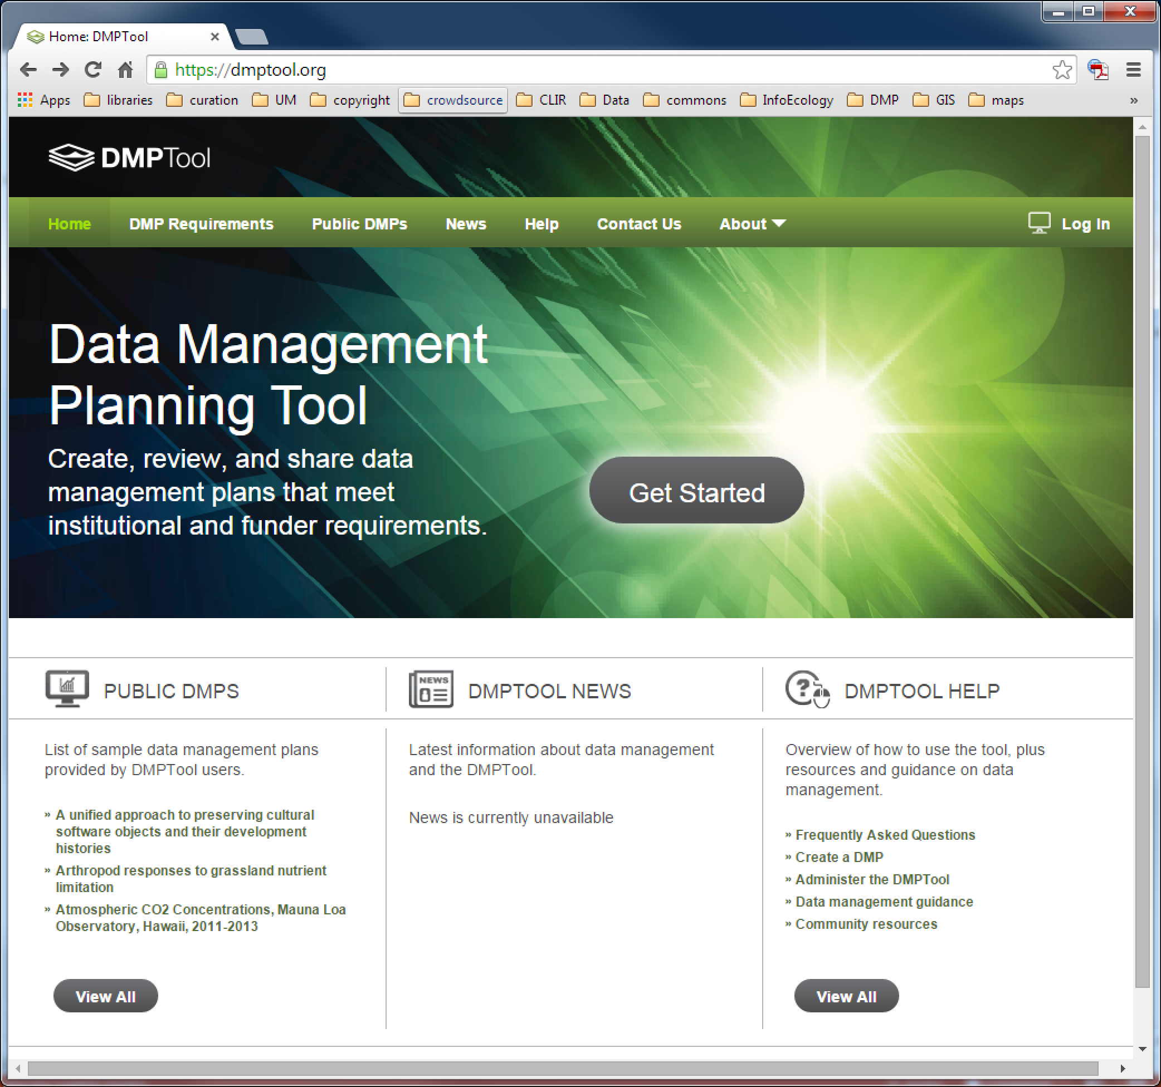

Slide 30



https://dmponline.dcc.ac.uk/

Slide 31
Quick Review: Data Management Plans
Information about Data and Data Formats
Metadata Content and Format
Policies for access sharing and re-use
Long-term storage and preservation
Budget
BUT it always will depend on your goals and the funder’s goals

Slide 32
Why Manage Data
X
Productivity
Publishing
Knowledge creation
Career advancement
+
Compliance
Grant writing
University policy
Research ethics
http://www.pd4pic.com/images800_/carrot-orange-vegetable.png
http://www.pd4pic.com/images/stick-outline-tree-branch-wood.png
Notes:
The Matrix - 1999
Big Data . . .
Talk to the data deluge, what are the responses in academia? In the public sector? Perhaps this is why we are here today?
NIH early data sharing requirements from grants over $500,000 – stringent controls for privacy and proprietary data
The 2011 NSF requirement to have data management plans in the grant proposals – there are program specific requirements
Most are simply two page documents with requirements to outline:
Data types to be collected
Standards to be used for metadata and data
Sharing policies (access, privacy, IP, etc.)
Re-use policies (distribution, derivatives
Plans for archival
Note that these requirements caused quite the scramble. No grant money if you could not include a plan.
Note that many foundations now also have data management requirements
Even private sector contracts require data management planning

Slide 33
Evaluate a DMP
The DART project - https://osf.io/qh6ad/
Complete /detailed | Addressed issue, but not complete | Did not address
Describes what types of data will be captured, created or collected
Describes how data will be collected, captured, or created (whether new observations, results from models, reuse of other data, etc.)
Identifies how much data (volume) will be produced
Describes how the data will be made publicly available
Provides details on when the data will be made publicly available
Other Criteria???

